Slide 1





Career Guidance
After 10th and 12th
Making the Right Choice for Your Future
Team entity..
Atul nath
05-09-2025
Sagar Institute of Science and Technology (SISTec) Gandhi Nagar Bhopal (M.P)
Notes:
1

Slide 2
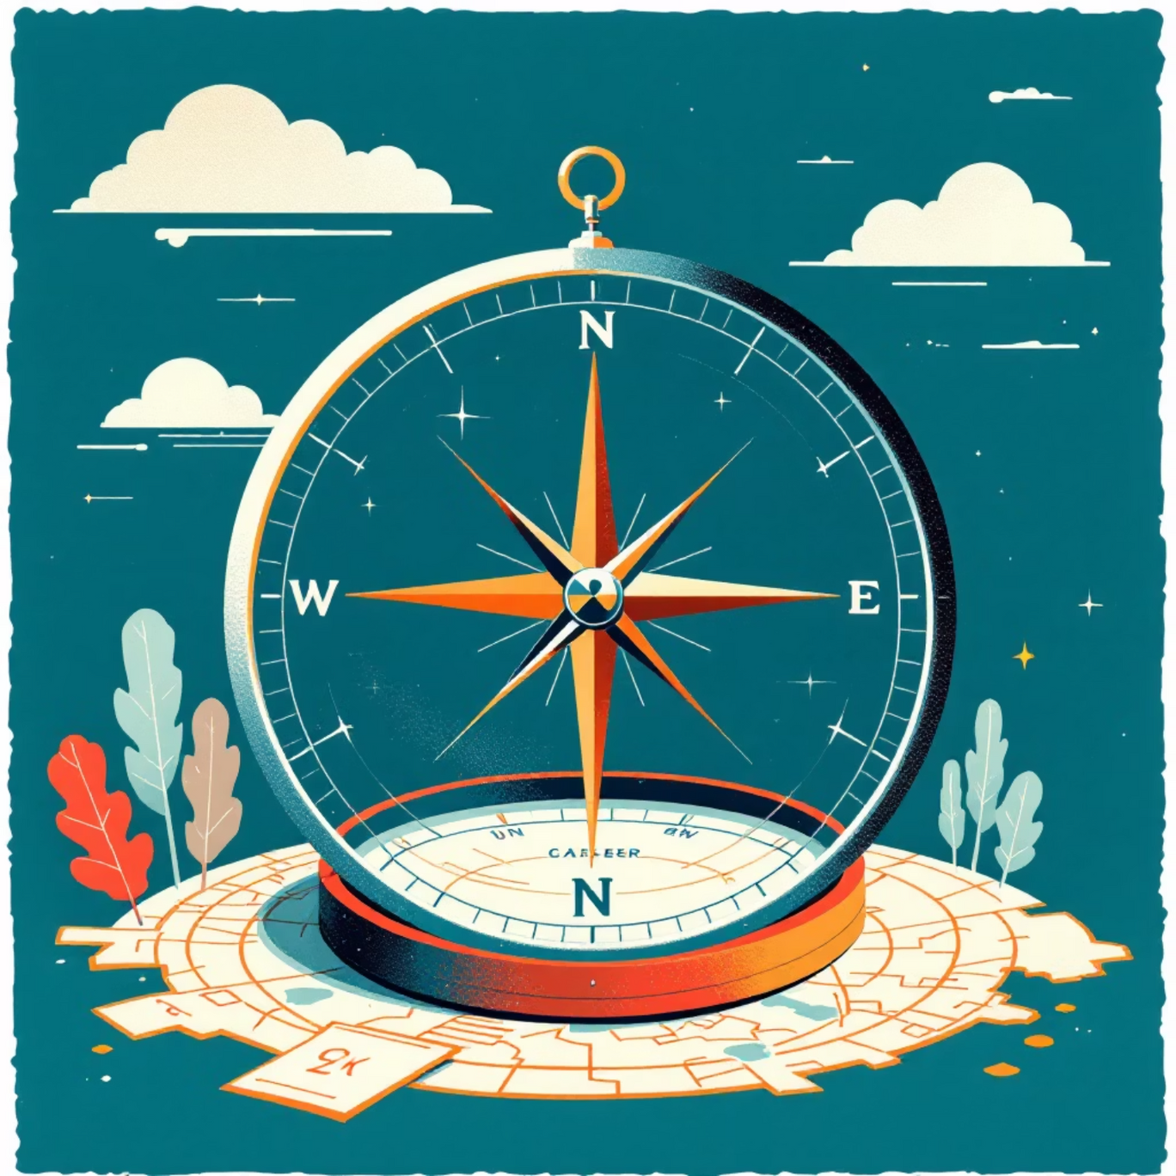
Navigating Your Path: What is Career Guidance?
Career guidance is an ongoing process that helps individuals understand themselves and the world of work. It involves exploring various career options, understanding their requirements, and making informed decisions aligned with one's aptitudes and aspirations.
For 10th and 12th graders, this stage is crucial. These are formative years where initial educational and vocational choices can significantly impact future opportunities. Strategic planning ensures a smoother transition into higher education or the professional world.
Notes:
2

Slide 3



Foundational Choices: Career Options After 10th Grade
After completing 10th grade, students face their first major academic decision: choosing a stream that aligns with their interests and future career goals.
Science Stream
Commerce Stream
Arts/Humanities Stream
Focuses on Physics, Chemistry, Biology, and Mathematics. Ideal for aspiring engineers, doctors, or researchers.
Covers Business Studies, Economics, Accountancy, and Mathematics. Suits those interested in finance, management, or entrepreneurship.
Includes History, Political Science, Literature, Psychology, and Sociology. Best for creative fields, social sciences, or civil services.
Each stream opens doors to a diverse range of undergraduate courses and professional opportunities.
Notes:
3

Slide 4

Beyond the Core: Vocational Paths & Diploma Advantages
Vocational Courses
Diploma Programs
These courses provide specialized training in fields like IT, hospitality, fashion design, or automotive repair. They are hands-on and career-focused, often leading to immediate employment.
Pros: Shorter duration, lower cost, practical focus, faster entry into the workforce.
Cons: May have limited career progression without further education, generally lower starting salaries.
Higher Secondary (11th & 12th Grade)
Pros: Broader academic foundation, eligibility for university degrees, wider range of career options, higher earning potential long-term.
Cons: Longer duration, higher cost, theoretical focus.
Notes:
4

Slide 5


Springboard to Success: Career Options After 12th Grade (Part 1)
The 12th grade marks a critical juncture, opening diverse pathways depending on the chosen stream.
Science Stream Pathways
Commerce Stream Pathways
B.Tech / B.E.: Engineering in various disciplines (Computer Science, Mechanical, Civil, Electrical).
B.Com: Bachelor of Commerce, foundational for business careers.
MBBS: Medicine, leading to a career as a doctor.
BBA: Bachelor of Business Administration, focused on management and entrepreneurship.
B.Sc.: Bachelor of Science in subjects like Physics, Chemistry, Biology, Mathematics, Computer Science.
CA (Chartered Accountant): Professional course for accounting and finance.
NDA (National Defence Academy): Career in the armed forces (Army, Navy, Air Force).
CS (Company Secretary): Specializes in corporate law and governance.
CMA (Cost & Management Accountant): Focuses on cost accounting and financial management.
Notes:
5

Slide 6


Diverse Horizons: Career Options After 12th Grade (Part 2)
Beyond Science and Commerce, Arts and various skill-based courses offer unique and rewarding career journeys.
Arts/Humanities Stream Pathways
Vocational & Skill-Based Courses
BA (Bachelor of Arts): Diverse subjects like Literature, History, Psychology, Sociology, Economics.
Paramedical Courses: Lab technicians, physiotherapists, etc.
Law (LLB): Path to becoming a lawyer or legal professional.
Graphic Design & Animation: For creative digital roles.
Journalism & Mass Communication: For careers in media, reporting, and public relations.
Digital Marketing: Essential skills for the modern business world.
Fine Arts (BFA): For aspiring artists, designers, and performers.
Hotel Management: Careers in hospitality and tourism.
UPSC Prep (Civil Services): Preparation for government administrative roles.
Fashion Design: For creative roles in the apparel industry.
Notes:
6

Slide 7







Spotlight: Why Choose Engineering (B.Tech)?
Engineering is a popular and dynamic field offering numerous opportunities for innovation and growth.
Vast Opportunities
Problem Solvers
Engineers are needed across almost every industry, from technology and manufacturing to healthcare and space exploration.
Develops strong analytical and problem-solving skills, highly valued in any profession.
High Demand
Innovation Hub
Consistent industry demand for skilled engineers, leading to promising career prospects and competitive salaries.
Be at the forefront of technological advancements and contribute to shaping the future.
Notes:
7

Slide 8





Making Your Decision: Key Factors to Consider
Choosing the right career path requires thoughtful consideration of several personal and external factors.
Interests & Passion
What subjects excite you? What activities do you genuinely enjoy? Aligning with your passions leads to greater job satisfaction.
Skills & Strengths
Identify your natural aptitudes and developed skills. Are you good at analytical thinking, communication, or creativity?
Job Market Trends
Research current and future demand for various professions. Consider emerging industries and skills in demand.
Financial Investment
Evaluate the cost of education and training versus potential future earnings. Consider scholarships and financial aid options.
Notes:
8

Slide 9






Empower Your Choice: Essential Tools & Resources
Numerous resources are available to help you make informed career decisions and prepare for your future.
Career Counseling Websites
Platforms offering aptitude tests, career quizzes, detailed career profiles, and personalized guidance (e.g., CareerBuilder, LinkedIn Careers).
Government Resources
Official government portals provide information on educational programs, vocational training, and employment statistics.
Entrance Exam Portals
Websites dedicated to specific entrance exams (e.g., JEE, NEET, CLAT, SAT) offer syllabi, practice tests, and application details.
Notes:
9

Slide 10
Your Future Awaits: Final Thoughts
The journey of career exploration is a continuous process of learning and adapting. Embrace it with curiosity and confidence.
"The future belongs to those who believe in the beauty of their dreams."
We've explored various academic and vocational pathways after 10th and 12th grades, discussed key decision-making factors, and highlighted valuable resources. Remember, your career path is unique, a blend of your aspirations and the opportunities you seize.
Notes:
10

Slide 11


